Slide 1
Data Driven Insights Into Medical Insurance

Slide 2
Outline
Executive Summary
Introduction
Methodology
Results
Conclusion

Slide 3
Executive Summary
Summary Of Methodologies
Data Collection: Accessed Health Insurance Data via Kaggle
Data Cleaning & Preparation:
Cleaned and formatted the data.
Conducted exploratory data analysis.
Conducted feature engineering
Interactive Visualizations: Created visual comparisons between patient health features and insurance charges.
Model Building & Evaluation:
Implemented Decision Trees, and Random Forest, XG Boost.
Tuned hyperparameters with GridSearchCV.
Evaluated models using test data accuracy.

Slide 4
Executive Summary
5. Summary of Results
Data Insights: · Identified key factors influencing medical insurance charges. · Visualized how age, BMI, smoking status, and region affects insurance cost trends.
Model Performance: · Decision Tree, Random Forest and XG Boost models achieved strong predictive accuracy. · XG Boost Fine Tuned performed best, capturing non-linear relationships between features and charges.
Key Findings: · Smoking status(79%) has the greatest impact on insurance costs. · Older individuals and smokers tend to pay significantly higher premiums. · The XG Boost model proved the most effective for predicting charges.

Slide 5
Introduction
Project Background And Context
With healthcare costs rising, it’s important for insurance companies to predict medical charges accurately based on individual factors. This project looks at how factors like age, gender, BMI, smoking habits, and region affect insurance costs. By using data analysis and machine learning, we aim to find the most important factors that influence medical expenses and create a system that can estimate charges more fairly and efficiently.
Problem Statement
What key factors most influence medical insurance costs?
How accurately can we predict insurance charges based on personal and lifestyle factors?
Which machine learning model provides the most reliable prediction of insurance costs?

Slide 6
Methodology

Slide 7
Data Collection
Step 1: Data Source (Kaggle Dataset)
Store Data Locally
Convert to DataFrame
Load For Analysis
Fetch
Data
Store Data Locally
Store Data Locally
Step 2: Data Wrangling
Encode Categorical Features
Normalize Numerical Features
Handle Missing Values
Step 3: Data Integration
Combine Cleaned Data
Verify Consistency
Final Dataset Ready

Slide 8
Data Wrangling
Verify Data
Accuracy
(consistency checks)
Identify Missing
Values (pandas.isnull)
Encoded Features Using One-hot Encoding
Verify Data
Accuracy
(consistency checks)
Impute/Remove Missing Data (fillna/dropna)
Scaling Features Using Log Scaler
Convert Data Types (pd.BMI, astype)
Feature Engineering (create new columns)
Check for Duplicates (pd.duplicated, drop)
Verify Correlation Between Values

Slide 9
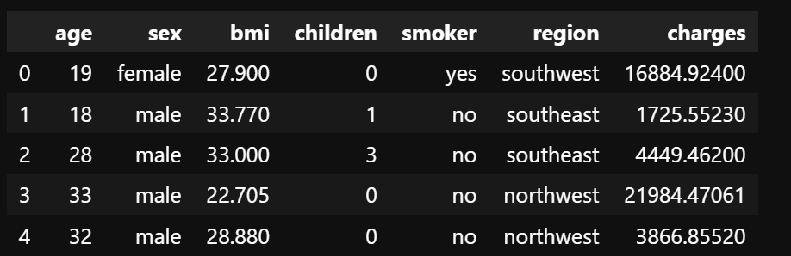
Dataset

Slide 10
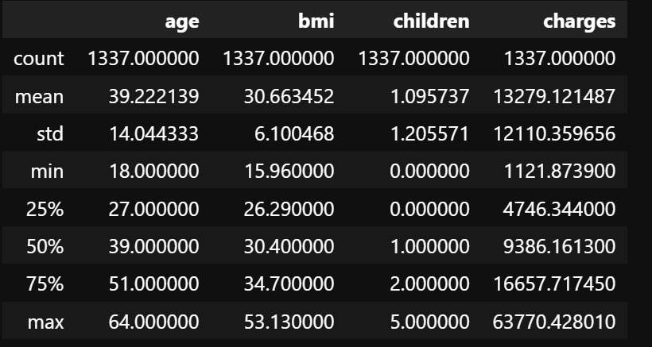
Statistical Description Of The Dataset

Slide 11
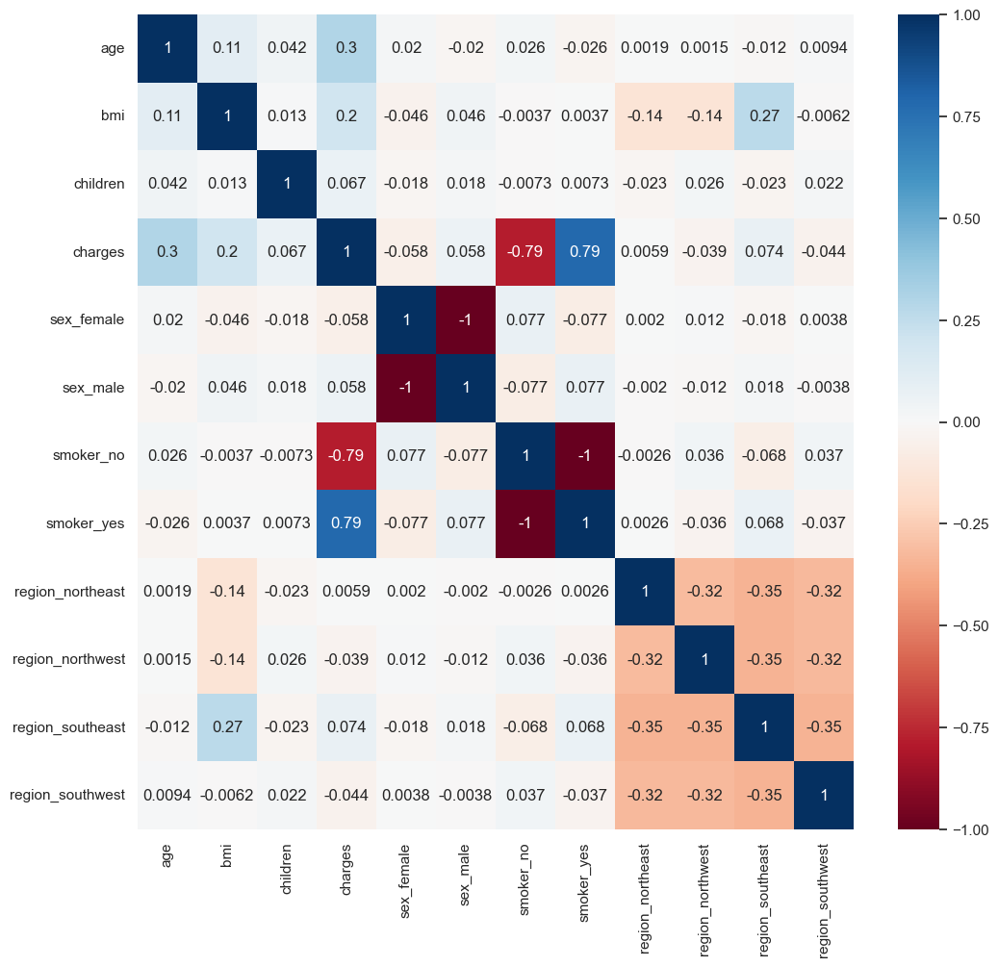
Data Visualization

Slide 12
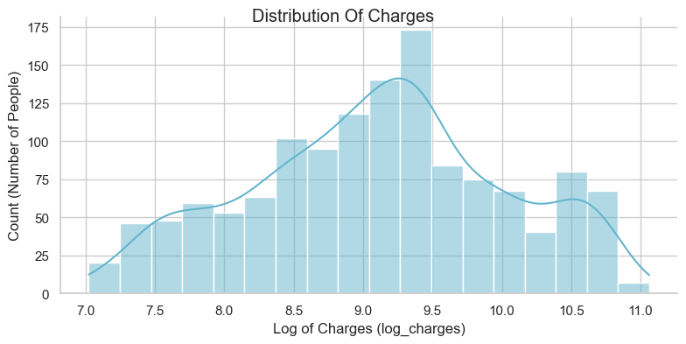
Distribution Of Charges To Patients

Slide 13
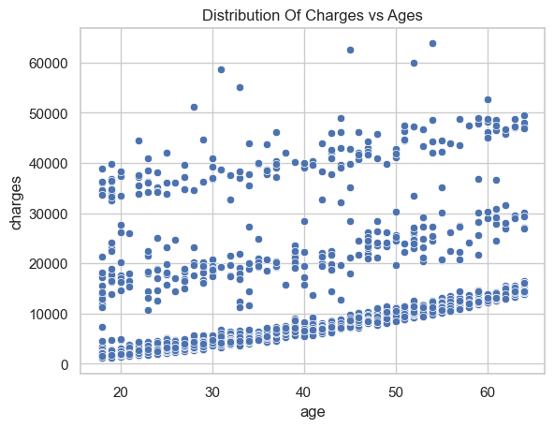
Relationship Between Charges Vs Ages

Slide 14
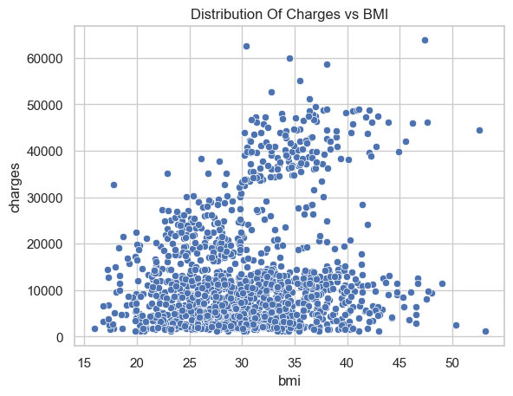
Relationship Between Charges Vs BMI
This indicates that there’s a mild positive trend, but scattered. This visualization indicates that a higher BMI can sometimes lead to higher insurance charges.

Slide 15
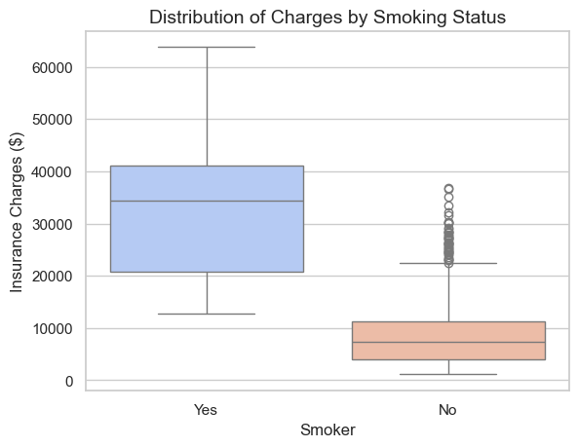
Relationship Between Charges Vs Smoking
This visualization indicates a strong relationship between smoking status and insurance charges. Hence, an individual smoking significantly affects their charges.

Slide 16
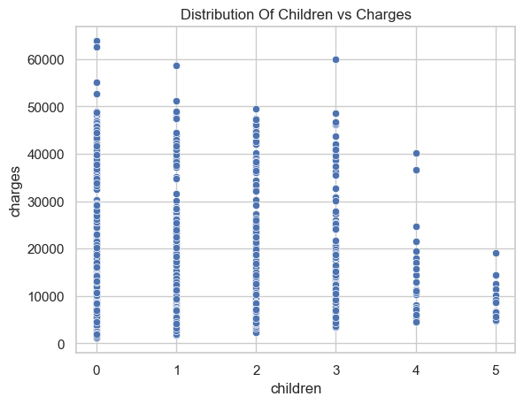
Relationship Between Charges Vs Children
This visualization indicates no strong relationship between the number of children and insurance charges. Hence number of children doesn’t significantly affect charges.

Slide 17
Predictive Analysis (Regression)
Preprocessing: - The dataset was standardized to ensure equal feature contribution and then split into training and testing sets for reliable validation.
Model Selection: - Implemented and compared multiple regression algorithms, Decision Tree, and Random Forest and XG Boost to predict insurance charges.
Hyperparameter Tuning: - Applied GridSearchCV to find the best parameter combinations, improving each model’s accuracy and performance.
Model Evaluation: - Models were evaluated using R² and Mean Squared Error (MSE) to measure predictive strength and reliability.
Improvement Iterations: - Adjusted model parameters and re-evaluated results to enhance predictive precision.
Best Model: - The XG Boost Model achieved the highest accuracy and lowest error, making it the optimal model for predicting insurance charges.

Slide 18
Predictive Analysis (Flowchart)
Data Preprocessing
Best Performing Model
Model
Selection
Improvement
Iterations
Hyperparameter
Tuning
Model
Evaluation

Slide 19
Results

Slide 20
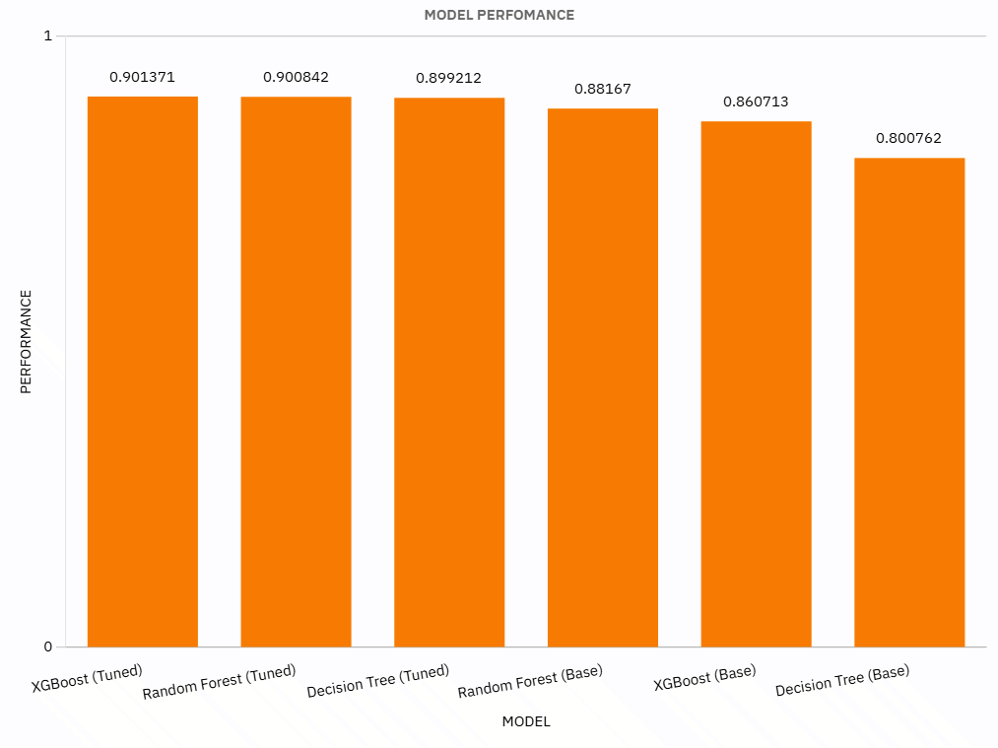
Regression
Accuracy
Based on the results, the XG Boost model has the highest accuracy on the test data, achieving an accuracy of 0.901. This suggests that the XG Boost model is better suited for this dataset compared to Random Forest, and Decision Tree all of which achieved an accuracy of about 0.800-0.900

Slide 21
Conclusion
Point 1: Our analysis showed that smoking is the biggest factor affecting insurance costs. Smokers almost always pay much more than non-smokers, showing how lifestyle choices can impact healthcare expenses.
Point 2: Age and BMI both have a mild positive relationship with insurance charges older people and those with higher BMI usually face higher costs, which reflects greater health risks.
Point 3: There wasn’t a strong link between the number of children and insurance charges, which suggests that family size doesn’t affect medical expenses as much as health and lifestyle factors.

Slide 22
Conclusion
In conclusion, our analysis and visualizations show the main factors that affect medical insurance costs. Age, BMI, and smoking habits all influence how much people pay. These findings can help insurance companies set fairer prices and also encourage people to make healthier choices to reduce their medical expenses.”

